Slide 1

A Minority within a Minority:
A Culturally Humble Approach to Disability & Racial Equity
Dr. Nekolas Milton, PsyD
Deeper Than Color
Pepperdine University

Slide 2
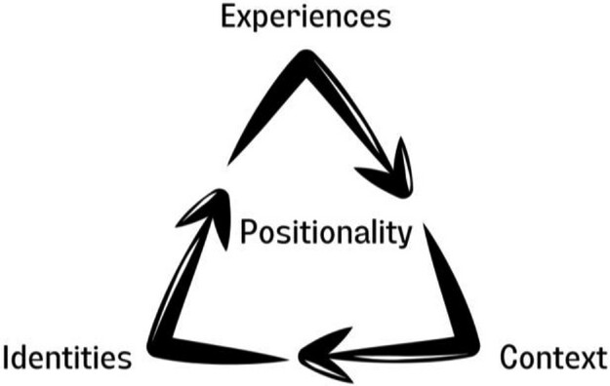
Positionality
HoH
Provider's lens

Slide 3
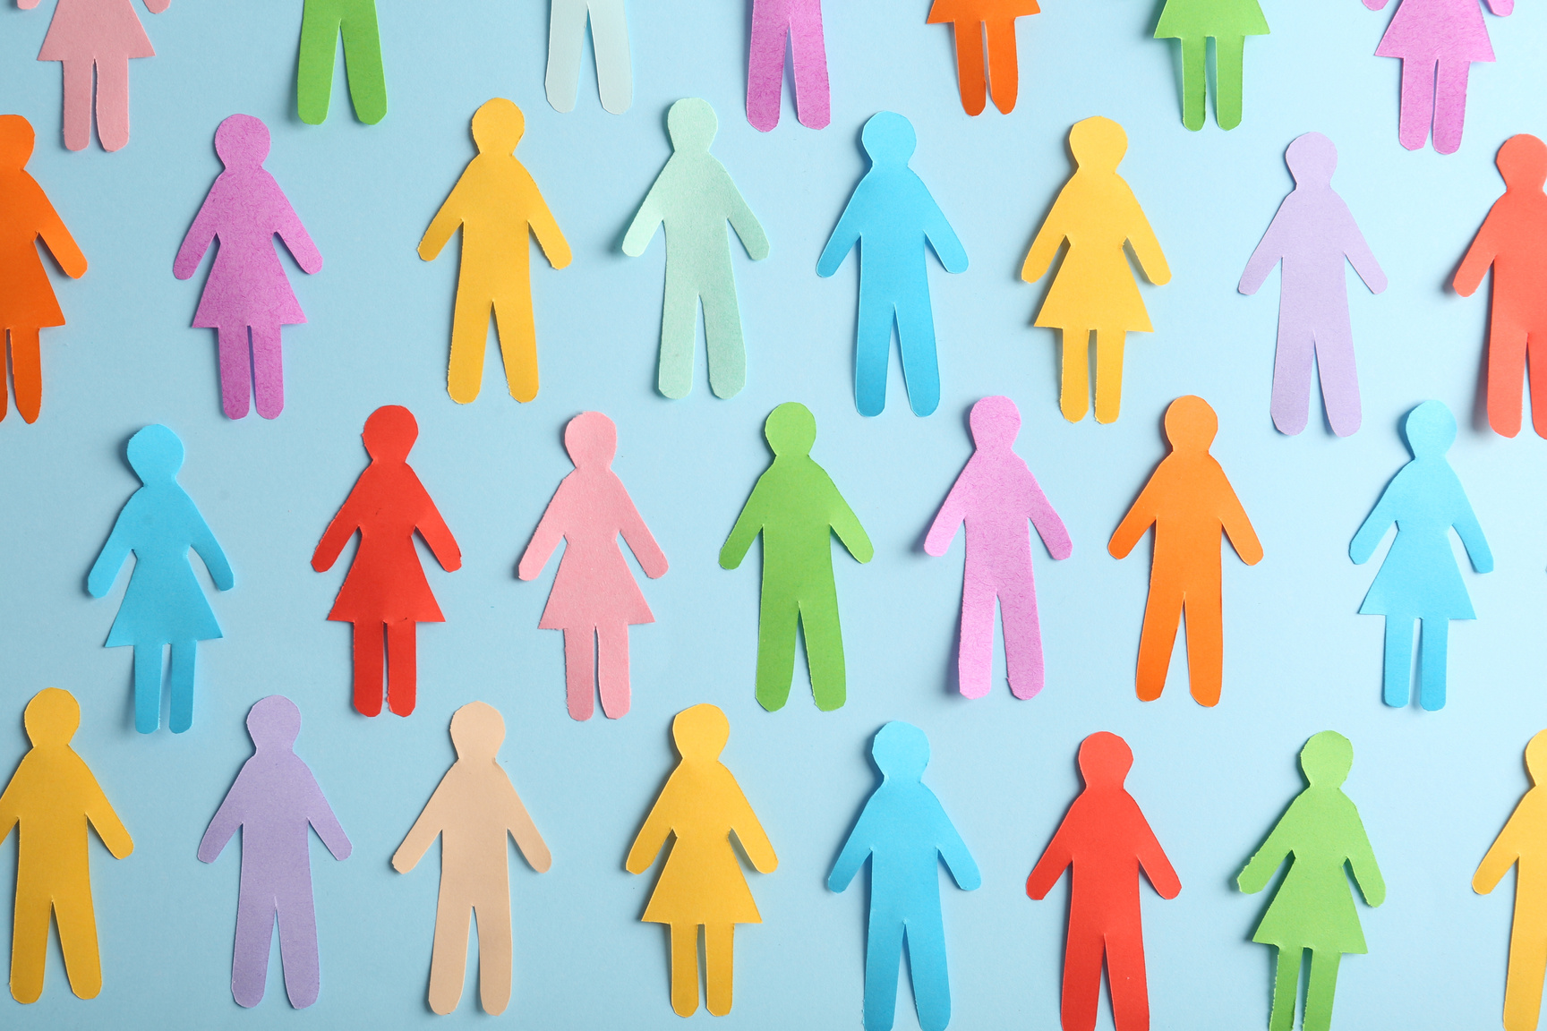
Intersectionality
Cultural Humility
Social Wheel
Agenda

Slide 4

GOALS
  Review Intersectionality as it relates to disability and other cultural identities.
  Introduce the concept of cultural humility and how it can be incorporated in the workspace.
  Engage in a experiential activity to encourage attendees to consider their identities critically and how identities are more or less keenly felt in different social contexts.

Slide 5
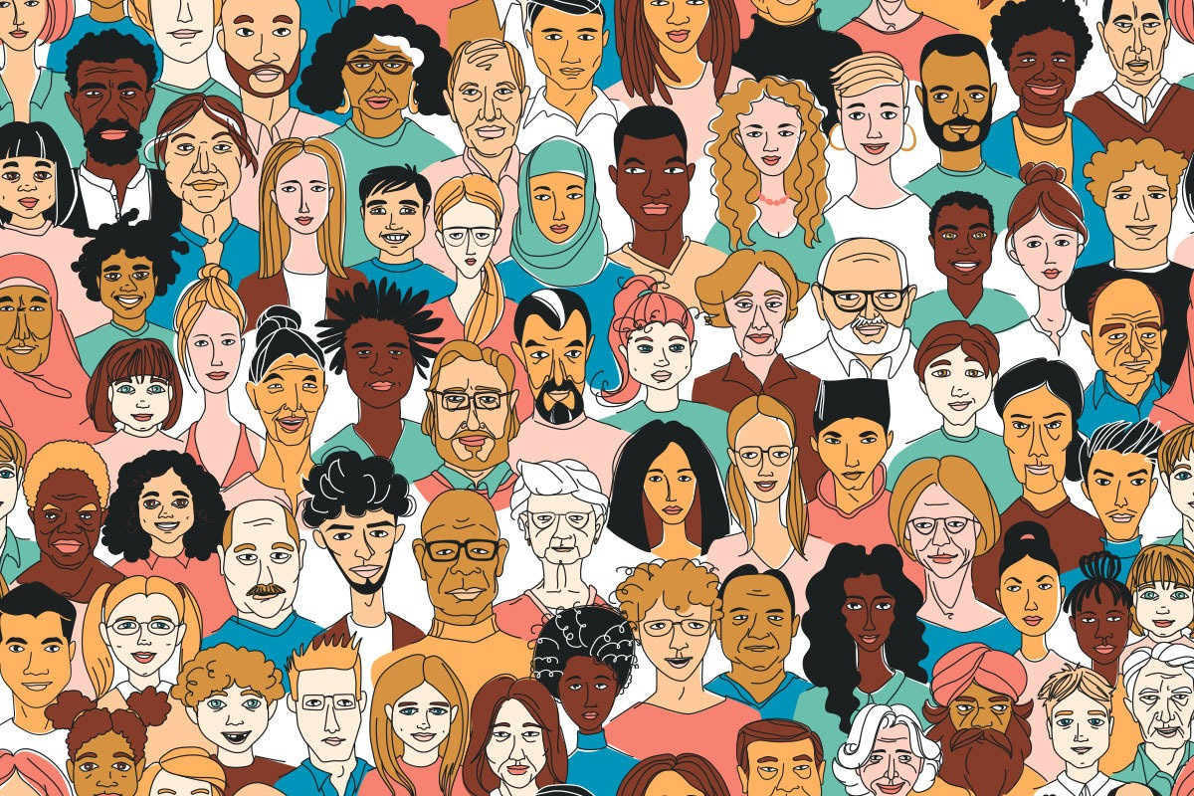
SOCIAL IDENTITY
“Social identity is the individual’s self-concept derived from perceived membership of social groups." (Hogg and Vaughan, 2002)
Includes but is not limited to;
  Gender
  Race
  Ethnicity
  SES
  Nationality
  Age
  Religion
  Disability
  Language
  Political affiliation
  Sexual orientation

Slide 6

"A LENS, A PRISM, FOR SEEING THE WAY IN WHICH VARIOUS FORMS OF INEQUALITY OFTEN
operate together and exacerbate each other"
(Kimberlé Crenshaw, 2020)

Slide 7
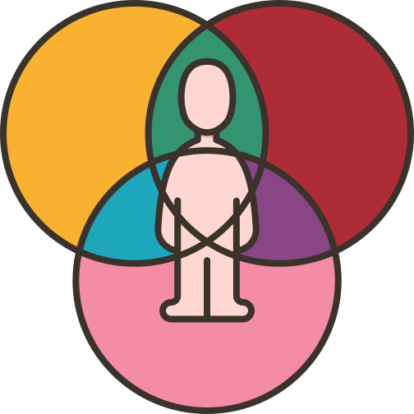
Intersectionality
  Coined in 1989 by Kimberlé Crenshaw to explain the differences of Black women in the legal system compared with White women and men.
  A lens for understanding how individuals experience the social environment.
  Individuals are shaped by their intertwined social identities. Each identity has different levels of power and privilege in our society but the person is shaped by the totality of this power.
  The interdependence of your identity interacts with systems and structures of power.
  These systems and structures of power help to create and perpetuate oppression of marginalized groups.

Slide 8
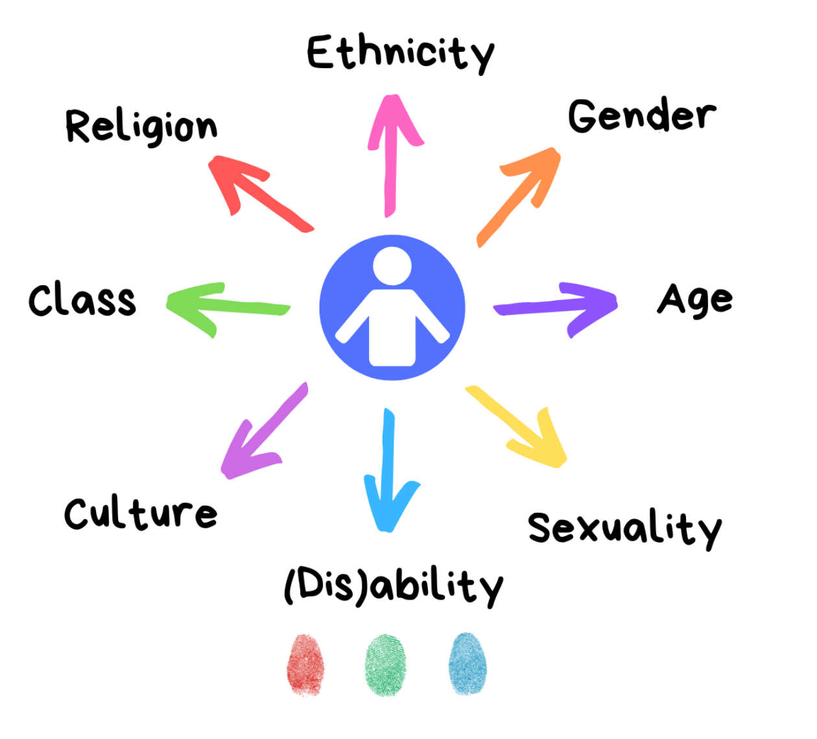

Slide 9


Slide 10
"THERE IS NO SUCH THING AS A SINGLE-ISSUE STRUGGLE BECAUSE WE DO NOT LIVE SINGLE-ISSUE LIVES"
Audre Lorde

Slide 11

The Urgency of Intersectionality
  One fifth of the nation’s 61 million individuals with disabilities are people of color.
  National Disability Institute concluded that while there are racial disparities present — in education, employment, and financial security, they grow deeper when disability is an added factor.
  The combination of race and disability mostly affects Black and Indigenous people. They are more likely than white individuals to have a disability, and that disability is more likely to magnify the discrimination and hurdles that they already face in housing, employment, and health care.
  Just one quarter of Black Americans with disabilities, for instance, have jobs, an employment rate at least 10 percentage points lower than that for white, Latinx, and Asian American disabled people.
  People of color with disabilities often can’t access affordable home care and are more likely to wind up in poorly financed nursing homes.
Notes:
health disparities can’t be solved without a focus on the intersections of race and disability.

Slide 12
The Urgency of Intersectionality
  Black and Latino individuals with disabilities are significantly more likely to have been arrested by age 28 than their white counterparts.
  One third to one half of police killings involve people with disabilities, many of them Black men.
  Discriminatory practices are compounded when disability impacts people of color, from under-representation in special education programs to over-representation in prisons.
  People of color with disabilities are stuck in the middle because needs cannot be met through a single- issue lens. Rather an intersectional focus is needed to understand how multiple identities impact their lives.
Notes:
health disparities can’t be solved without a focus on the intersections of race and disability.

Slide 13
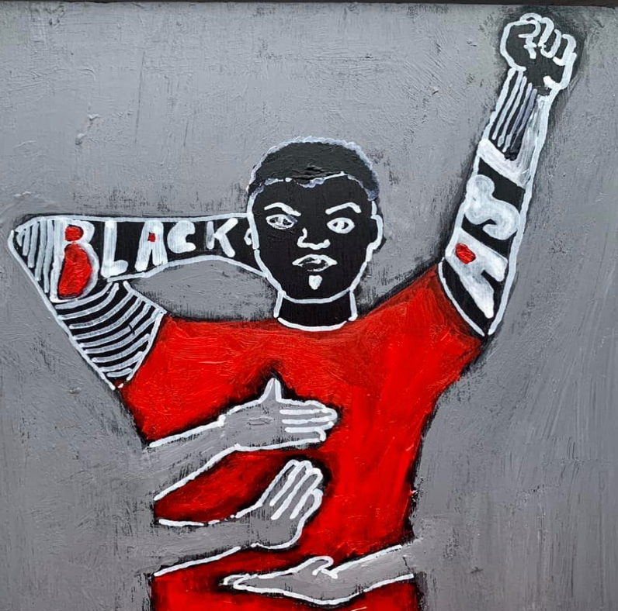
A Black Deaf Lens
  The dynamics of Deaf culture in the United States, often refers to white Deaf culture.
  The Black Deaf community experiences discrimination from majority and minority populations.
  The overall employment rate for Black Deaf individuals is 34.2% while their hearing counterpart is 64.6% and White Deaf individuals is 50.6%.
  Scant empirical articles on the mental health needs of Black Deaf individuals.

Slide 14
“HAVING A SENSE THAT ONE’S OWN KNOWLEDGE IS LIMITED AS TO WHAT TRULY IS ANOTHER’S CULTURE.” (HOOK ET AL. 2013)

Slide 15

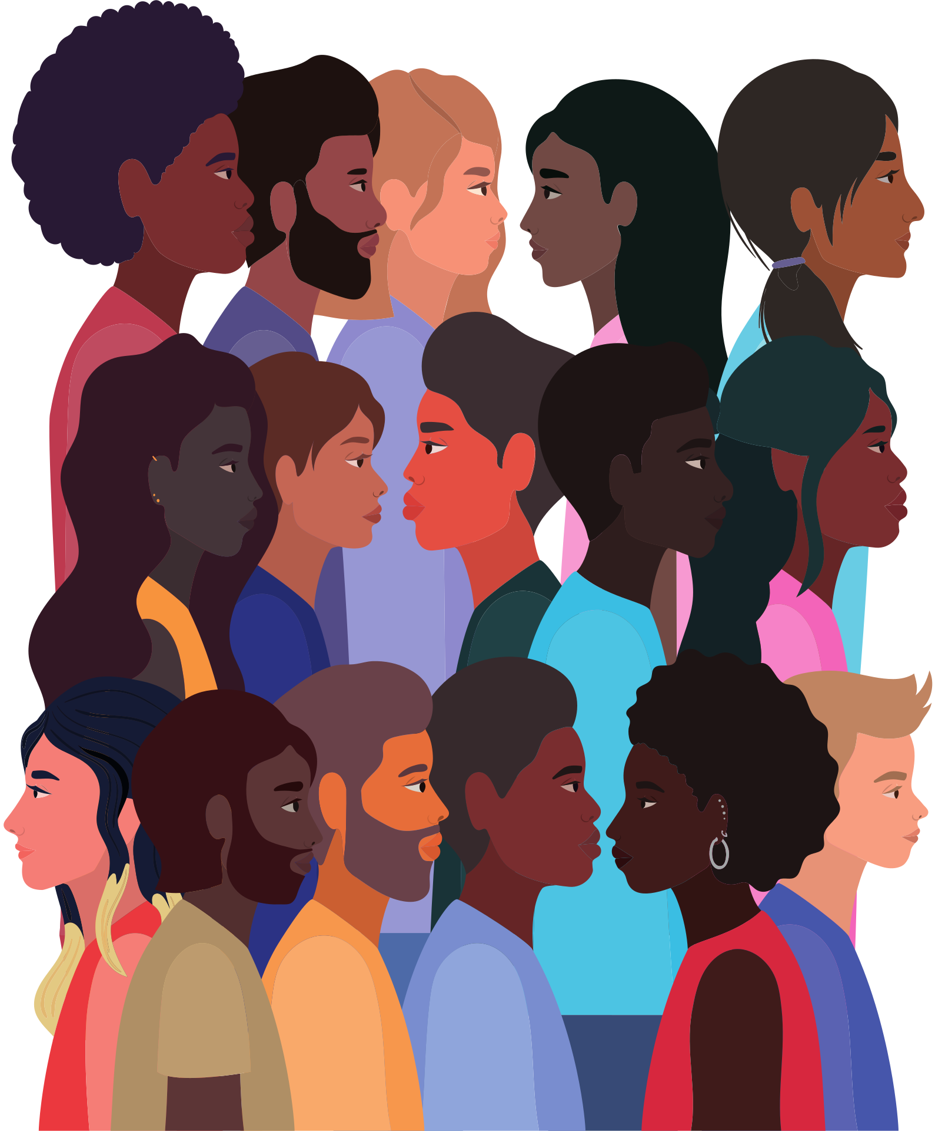
Cultural Humility
A personal lifelong commitment to self-evaluation and self-critique whereby the individual not only learns about another's culture, but one starts with an examination of her/his own beliefs and cultural identities. Additionally displays an openness to new ideas, contradictory information, and advice.

Slide 16
Cultural Humility
  Intentional
  Honoring beliefs, customs, and values
  Self-exploration
  Recognizes challenges in power imbalances
  De-emphasizes cultural knowledge and competency

Slide 17
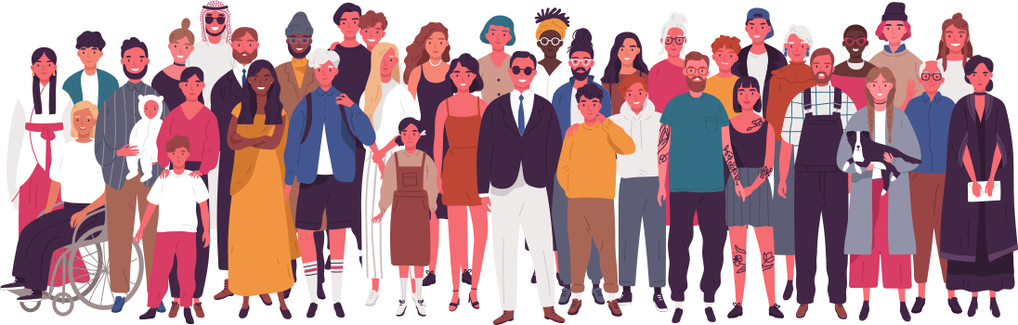
Core Components of Cultural Humility
  Lifelong learning and self-reflection.
  Actively addressing power imbalances and inequity.
  Institutional accountability.

Slide 18
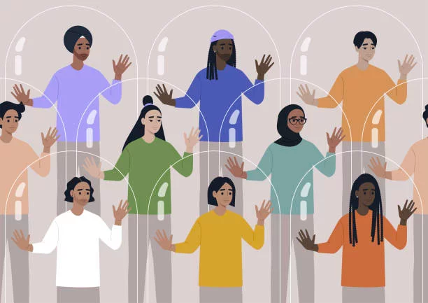
Barriers to Practicing Cultural Humility
  Attitudinal/Behavioral
  Systemic/Institutional

Slide 19
Attitudinal/Behavioral
Disability Stereotypes
  Attributes used to characterize a group and its members
  Cause of prejudice
  Stereotypes differ based on disability and gender
  Implications:
    Public Policies
    Healthcare
    Legislative decisions

Slide 20
Attitudinal/Behavioral
Conscious Bias
  Very clear about his/her/their feelings and attitudes, and related behaviors are conducted with intent
  Overt negative behavior
    Physical or verbal harassment
  Exclusion
Unconscious/Implicit Bias
  Operates outside of the person’s awareness and can be in direct contradiction to a person’s espoused beliefs and values.
  Can interfere with clinical assessment, decision-making, and provider-patient relationships.

Slide 21
Microagressions
Brief and commonplace daily verbal, behavioral, and environmental ingredients, whether intentional or unintentional, that communicate hostile, derogatory, or negative racial slights and insults to the target person or group.

Slide 22
Systemic/Institutional
Systemic Racism
  A combination of systems, institutions and factors that advantage white people and for people of color, cause widespread harm and disadvantages in access and opportunity.
  Is leadership taking a stance of anti-racism?
  Outdated policies and laws.
  Impact on overall health and wellness

Slide 23
Systemic/Institutional
Policy and Programmatic Challenges
  Denial of qualified individuals with disabilities to participate in life-sustaining and increased quality of life services and programs
  Outdated polices and procedures
  Lack of knowledge
  Denial of reasonable accommodations

Slide 24
Core Components of Cultural Humility
  Lifelong learning and self-reflection.
  Actively addressing power imbalances and inequity.
  Institutional accountability.

Slide 25

Lifelong learning and self-reflection
Think of a time when you were not as effective as you wanted to be for someone needing your help.
What norms or value may have kept you from connecting? Kept you from learning something new?
What could you/have you learned from the experience?

Slide 26
Lifelong learning and self-reflection
This is a commitment to learning about one’s own and others’ cultures, backgrounds and experiences. It is also about taking on an open and curious mindset that acknowledges we are never done learning and growing. Some actions organizations can take include:
  Encouraging team members to engage in dialogues about their experiences and cultures.
  Creating opportunities for team members to get to know each other and build interpersonal relationships.
  Providing team members with resources to support their learning growth.
  Planning activities and events that celebrate cultures and provide opportunities for learning engagements.

Slide 27
Actively addressing power imbalances and inequity
Think of a time when you stood up for equality or peace. It could be that you said something in the moment or engaged someone in discussion later.
How did you feel? Emotionally? Physically?

Slide 28
Actively addressing power imbalances and inequity
Understanding and addressing power imbalances requires acknowledging that we are complicit players in an unfair power structure and encourages us to help fix disparities by being respectful allies. This includes asking yourself, “How can I grow and use my understanding of my own and others’ culture and experiences to disrupt inequity and exclusion in the workplace?” A few ways organizations can help team members understand and address power imbalances in the workplace include:
  Offering resources for team members to better understand the history of discrimination and oppression, as well as the impact it continues to have on systemically excluded groups and cultures today.
  Providing opportunities for team members to engage in brave conversations about their power, privilege, and the responsibilities that come with it.
  Including team members in conversations about how one can develop and evaluate culturally relevant and appropriate interventions to advance equity and inclusion.
  Offer leaders opportunities to come together and reflect on the power and privilege they may hold and assess what role they have in addressing power imbalances, fostering cultural humility, and creating an inclusive and equitable workplace.

Slide 29
Institutional Accountability
How does one tell if an organization practices cultural humility?
How does it connect to your motivation to be an effective and compassionate leader?

Slide 30
Institutional Accountability
Holding the workplace and it’s systems accountable for providing inclusive and equitable spaces ensures that cultural humility is impactful and truly creates an equitable and inclusive workplace. It’s about asking yourself, “how can I work on an institutional level to ensure the systems I am a part of or engage with will work towards nurturing further equity and inclusion?” Examples of some actions include:
  Offering team members opportunities to participate and contribute to DEI work.
  Collecting and analyzing data about organizational practices, policies, programs, services, and community partnerships through a DEI lens.
  Developing goals and action plans that incorporate cultural humility to stay accountable.
  Reviewing policies and practices for bias and rewriting them to make them reflective of various stakeholders’ cultures, customs, behaviors, and information needs.

Slide 31



Social Wheel Activity

Slide 32

Questions

