Slide 1
Paid Family Caregiving: part 1
Q&A

Slide 2
Agenda
The path to get here
The new law
  Goals
  What does it actually do?
  How was it amended
What comes next?
Q&A

Slide 3
How we got here
Nov/Dec 2023 – Focus groups
  Lived experiences and policy preferences
Jan 2024 – Introduce PFC Resolution
Feb 2024 – Paid Family Caregiving Webinar 1
April 2024 – Pass PFC Resolution
Summer 2024 – working on TennCare/DDA
Fall 2025 – Research and development of HB712/SB1178
Jan 2025 – Introduce bill
Feb 2025 – Paid Family Caregiving Webinar 2
March 2025 – Disability Day on the Hill – Senate Health
April 2025 – Pass bill
June 2025 – TennCare/DDA meeting
July 1, 2025 – Bill becomes law

Slide 4
HB-712/SB-1178
Goals of the bill:
  To reduce any final formal policy and rule barriers for family members to be hired by a provider agency to be paid to care for a loved one
  To provide provider agencies assurance and guidance regarding the hiring and employment of family caregivers
  To lay the foundation for building a more comprehensive program

Slide 5
HB-712/SB-1178
What it actually does:
  Well, not much, technically
  The bill states that TennCare and DDA may not create policies or rules that prohibit or otherwise dissuade providers from hiring qualified family members based on:
    where they live
    who they are caring for
    the age of the person being cared for
    the age of the caregiver
    the waiver program they are enrolled in
    the employment of a non-related caregiver
    parental or spousal relationship
  The bill also requires TennCare and DDA to issue a guidance document to providers about the law (and permits them to promulgate rules)

Slide 6
HB-712/SB-1178
Things to know:
  This bill only applies to caregivers of individuals enrolled in a state Medicaid waiver program (like ECF CHOICES, CHOICES, etc.)
  This bill does not allow for those in consumer direction to hire themselves (no change to current law)
  A caregiver is not subject to income or asset limits, but the person receiving care is (21+)
  A caregiver is likely subject to income and asset limits if they are caring for a dependent
  The bill does not REQUIRE provider agencies to hire a family caregiver
  The bill does not change how TennCare defines “qualified individual” when determining what care they will allow/pay for the caregiver to provide
  The Conservatorship problem (thanks DDA)

Slide 7
HB-712/SB-1178
The DDA Amendment
  How the bill was originally written:
    The guardianship or conservatorship status of the family care giver unless explicitly prohibited in guardianship or conservatorship documents;
  How DDA amended the bill
    The guardianship or conservatorship status of the family care giver unless explicitly permitted in guardianship or conservatorship documents;
  How did that happen?
  What it means and how we are trying to help in the short term

Slide 8
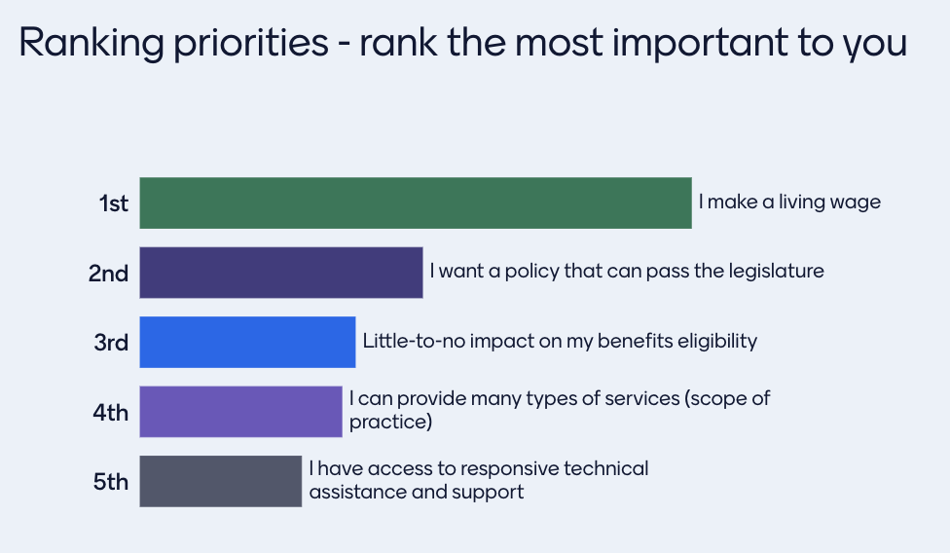
What comes next?
Paid Family Caregiving: Part 2
  Goals:
    Ensure that caregivers can be deemed “qualified” and are appropriately paid for more complex care tasks
    Ensure that caregivers have training and support available to them
    Ensure that caregivers have access to respite
    Expand eligibility?
    What else?

Slide 9
What comes next?
Summer: get input from families about what they want from a more formal, structured program
Late summer: recruit legislative champions/sponsors
Fall: Draft legislation, solicit feedback from community
January 2026: introduce legislation

Slide 10
Q&A
I am his mom, his legal guardian/conservator and he will live with me as long as I can care for him. We had several programs deny us when we lived in Texas because I was his mom, guardian and he lived in my home. Will this still be an issue with this new bill?
Will parents be able to get paid as well or just caregivers that are not parents?
How does this bill pertain to autistic children?
Can someone who has a Conservatorship of a family member be a paid caregiver?
What are the requirements? Can you utilize this program along with Katie Beckett or if you have adopted a special needs child who receives Medicaid?

Slide 11
Q&A
Will the paid-caregiving be cover families that home school their children under the age of 18 or for 18 and older?
Is this based on financial status of the caregiver?
I don't know much about the program but is it income based? Can it help provide funds for elderly parents or youth 18 and older with intellectual disabilities?
List of agencies for parents
I would love to know how this program works, what the requirements are, how much $ is paid, and how to apply to be a paid caregiver.
My father in law in nursing home, what can we do to get him home with help, Alzheimer's.

Slide 12
Q&A
Is any family eligible for paid caregiving if their child is under 18? And will they be paid for days when they don't have any nursing available? Do parents have to be hired by an agency
I work with families of children with chronic illnesses. Will there be a requirement to prove the severity of the illness to be eligible?
When will it begin? What is the criteria for eligibility?
How do we apply for it and my son is 3 years old.

Slide 13
Q&A
Open questions:
  Come off of mute, raise your hand or enter into chat

