Slide 1
Tennessee Disability Coalition
By the Numbers
FY24 Income – $2,560,180
FY24 Expenses - $2,536,570
Employees – 26
Central Office – Woodland Street, Nashville.
Home Offices
  East - 6
  Middle - 2
  West - 4

Slide 2
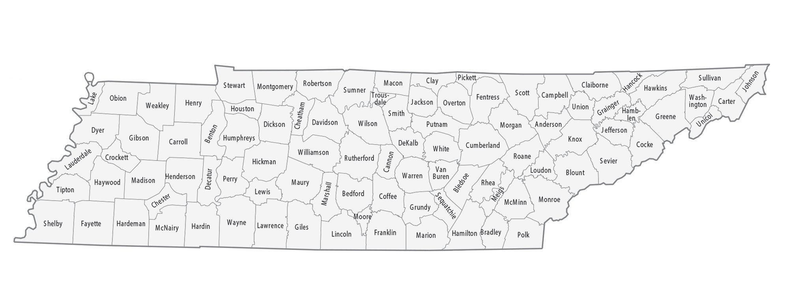
16 Board members from across the state

Slide 5




Program updates
Public Policy
  ADA
  OVW
  DDH
  RevUp
WorkAble
  Work Incentives and
  Planning
  Benefits to Work

Slide 6


Program Updates, continued
Family Voices of Tennessee
  Peer Support
  PEARS
  Family to Family Health Information
  LEND
Brain Links
  Training
  Tennessee Brighter Futures

Slide 7

TDC Board program
Small Grants
  Small grants since 2008
  Volunteer reviewers
  $1,103,856 in grants to TN organizations

